Slide 1
The Topology of Magmas
By Charlotte Aten
Advised by Jonathan Pakianathan, Ph. D
and Mark Herman, Ph. D
Department of Mathematics
University of Rochester

Slide 2
Visualization
Many people find visual representations of things easier to digest.
In mathematics visualization is ubiquitous and gives rise to geometry.

Slide 3
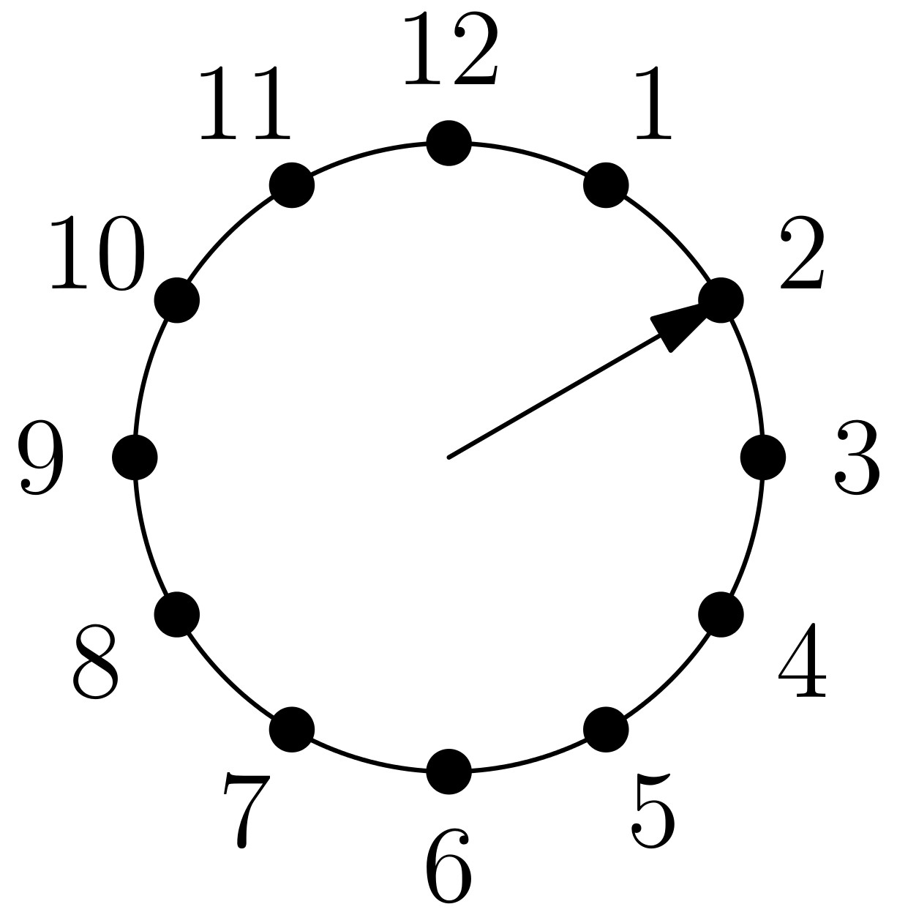
Clock arithmetic
Count “in a circle.”
We can take each time as a number of hours past 12 to “add on the clock.”
We can use 0 instead of 12 for convenience.

Slide 4
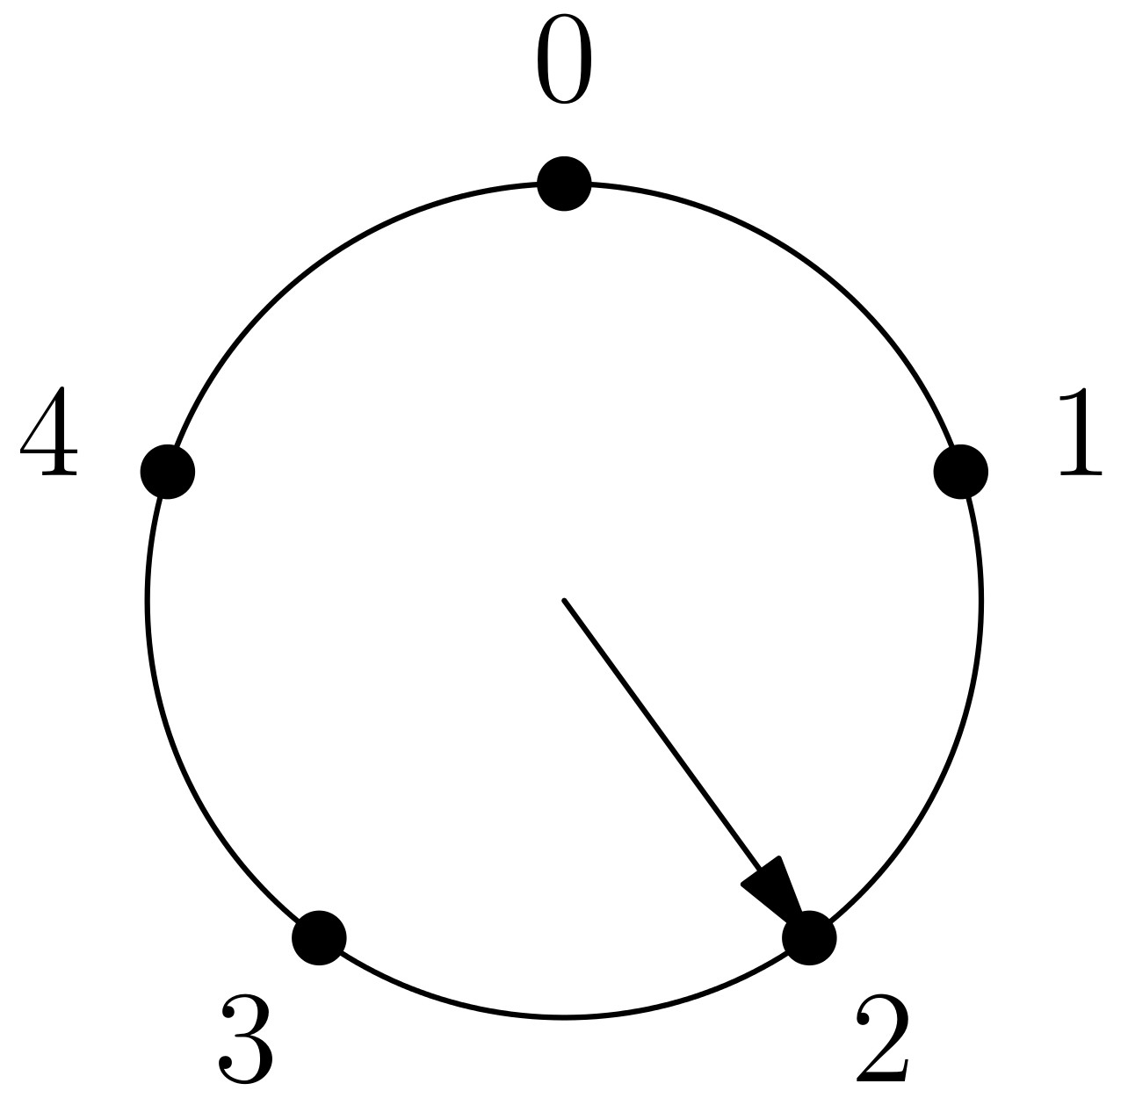
Clock arithmetic
We can have a “clock” or “number circle” of any size.
A number circle of size n is known as “the integers modulo n” or “the integers mod n.”

Slide 5
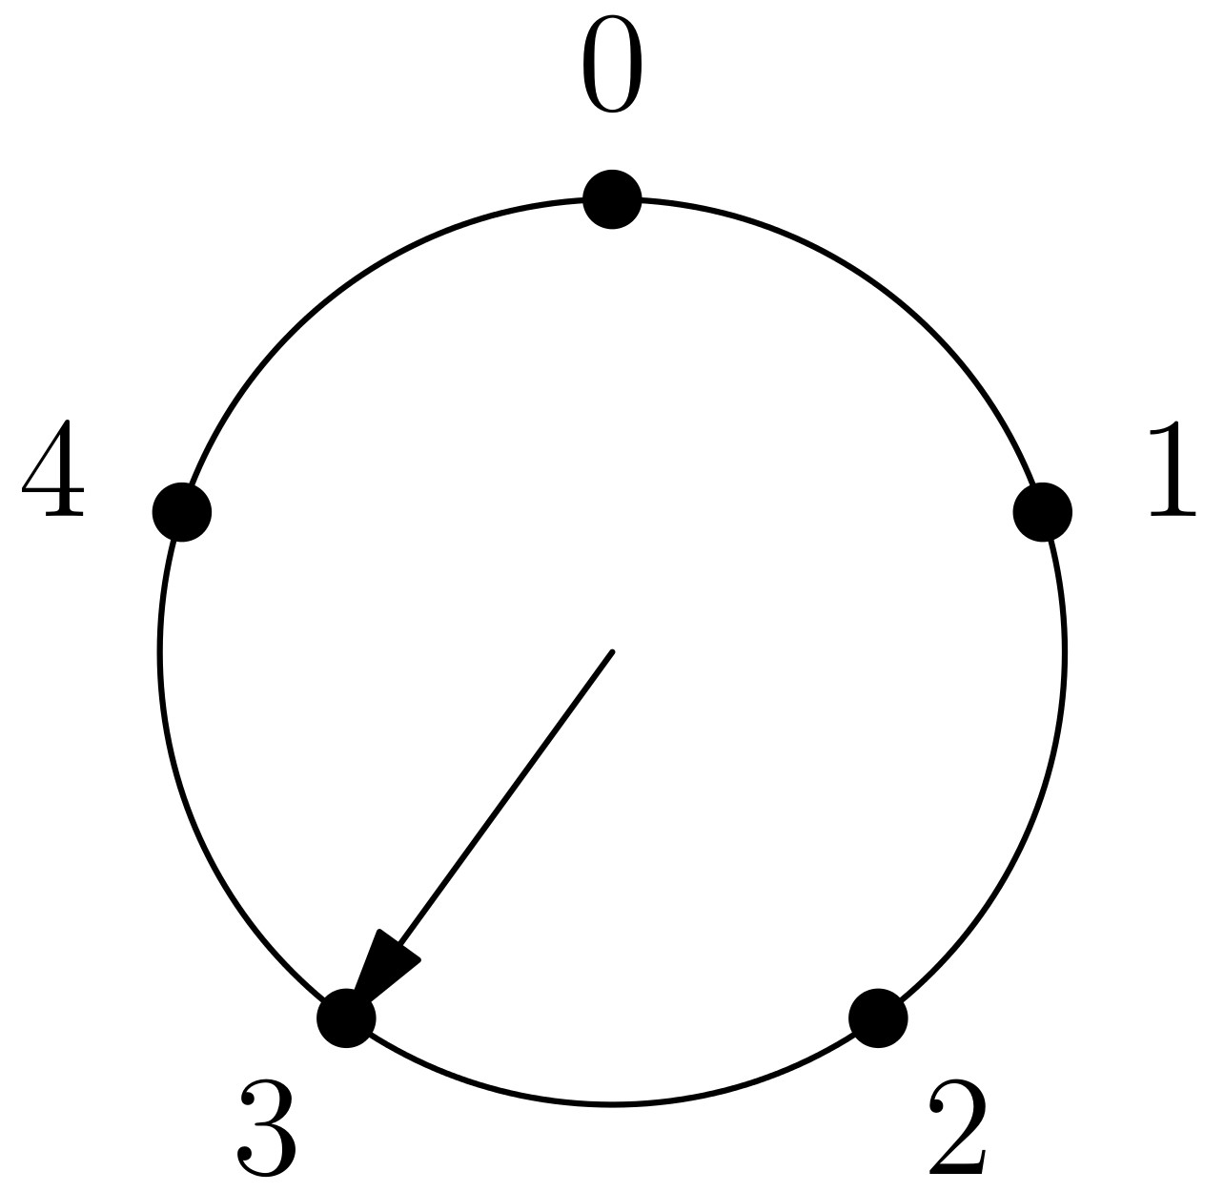
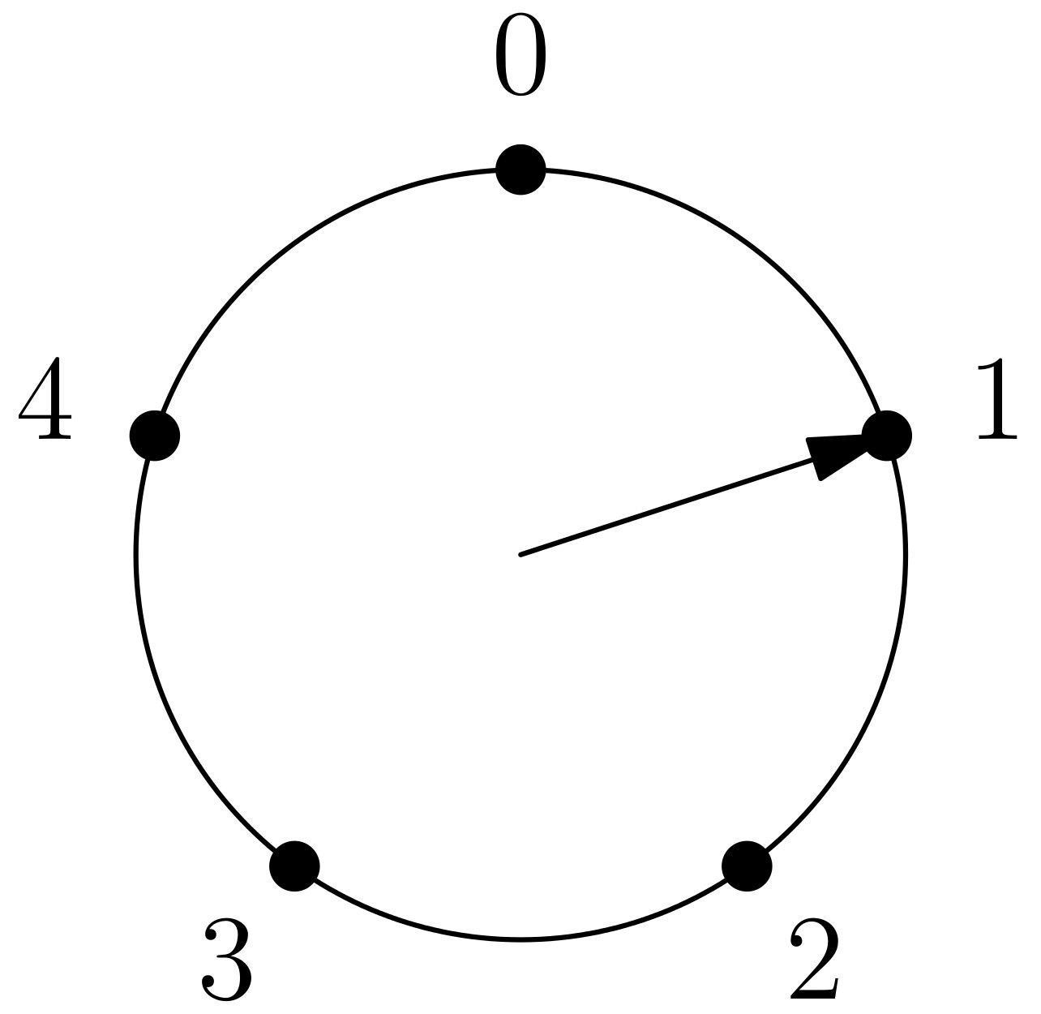
Clock arithmetic
We compute 3+3 in the integers mod 5 as an example.

Slide 6
Unary operators
Unary operators take things from one collection and give back things from another collection.
The two collections can be the same or share elements.
Word | First letter
Apple | A
Apricot | A
Banana | B

Slide 7
Examples of unary operators
Assigning a grade to each student at the end of a course.
Sending each season to the one that follows it.
Giving a name to each person.
Designating each area in a city for either industrial, residential, or commercial use.

Slide 8
Unary operators
Adding 2 in the integers mod 5 is a unary operation.
x | x+2
0 | 2
1 | 3
2 | 4
3 | 0
4 | 1

Slide 9
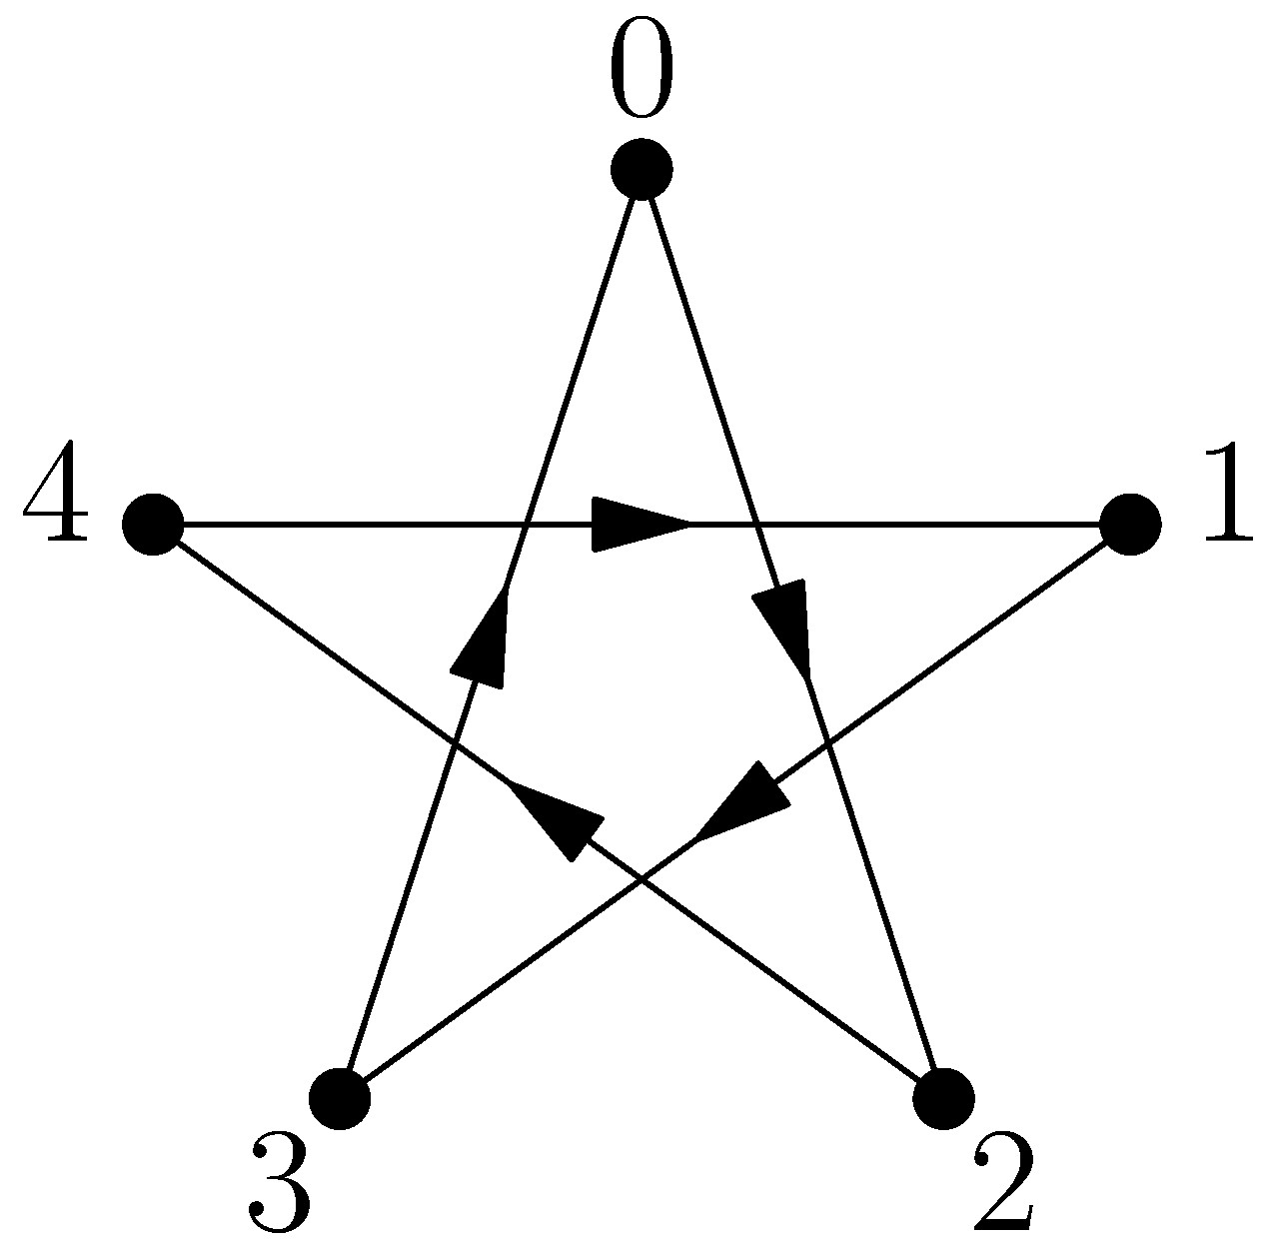
Operation digraphs
In order to see what is going on we can draw a dot for each number x and an arrow from x to x+2.
This is an example of an operation digraph.

Slide 10
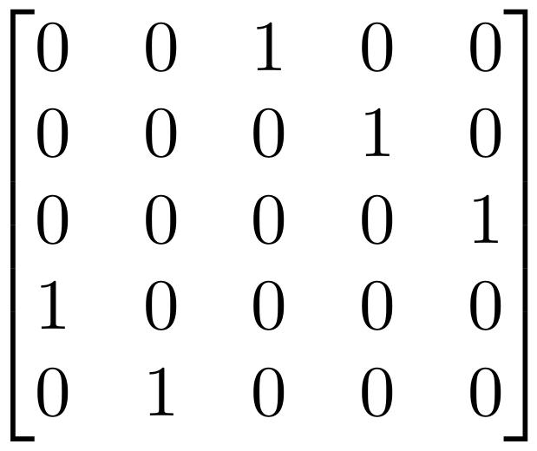
Adjacency matrices
Each digraph has a matrix associated with it, called an adjacency matrix.
This allows us to use matrix arithmetic to reason about unary operations.

Slide 11
Adjacency matrices
The rank of an adjacency matrix for an operation digraph is the number of vertices with an incoming edge.
If we look at a unary operation that takes x to f(x), this rank is the number of elements y for which the equation f(x)=y has a solution.

Slide 12
Adjacency matrices
A relationship called Sylvester's inequality gives a lower bound on the rank of a product of matrices.
Multiplying our digraph adjacency matrices corresponds to unary operation composition, so this inequality gives us a lower bound on the number of solutions to equations of the form f(x)=y, where f is the composition of many unary operators.
For example, f(x)=r(q(p(x)) for operators p,q,r.

Slide 13
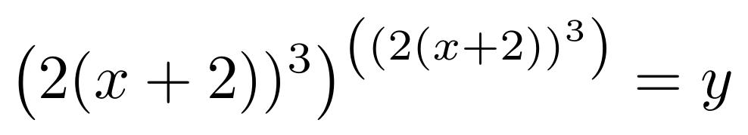
Adjacency matrices
The previous reasoning allows us to conclude, for example, that the following equation has at least two solutions over the integers mod 4.

Slide 14
Binary operations
Binary operations take two things and give back one thing.
The “un” in unary operation means “one input,” while the “bi” in binary operation means “two inputs.”
+ | 0 | 1 | 2 | 3 | 4
0 | 0 | 1 | 2 | 3 | 4
1 | 1 | 2 | 3 | 4 | 0
2 | 2 | 3 | 4 | 0 | 1
3 | 3 | 4 | 0 | 1 | 2
4 | 4 | 0 | 1 | 2 | 3

Slide 15
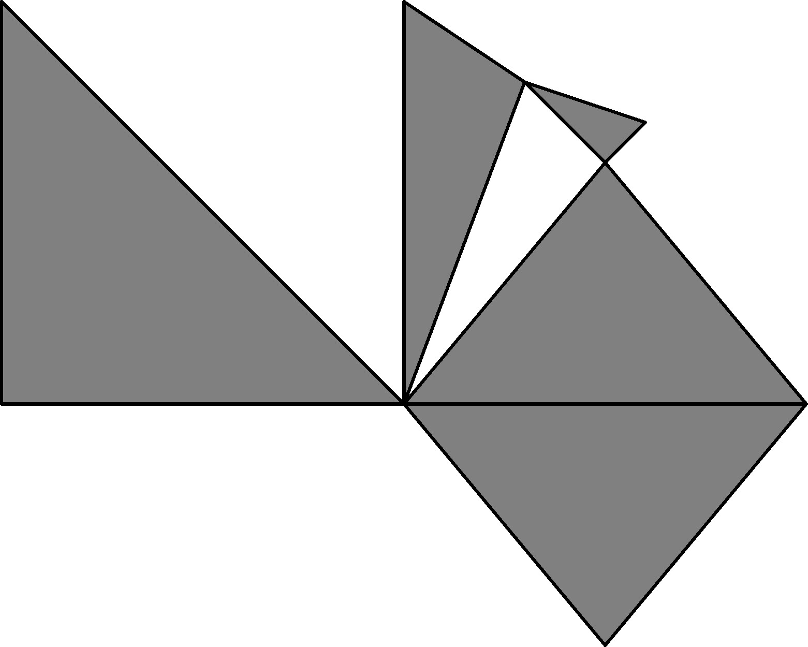
Simplicial complex construction
For our purposes, a simplicial complex is a collection of triangles joined at their vertices or edges.
In general n-dimensional analogues of triangles are allowed.

Slide 16
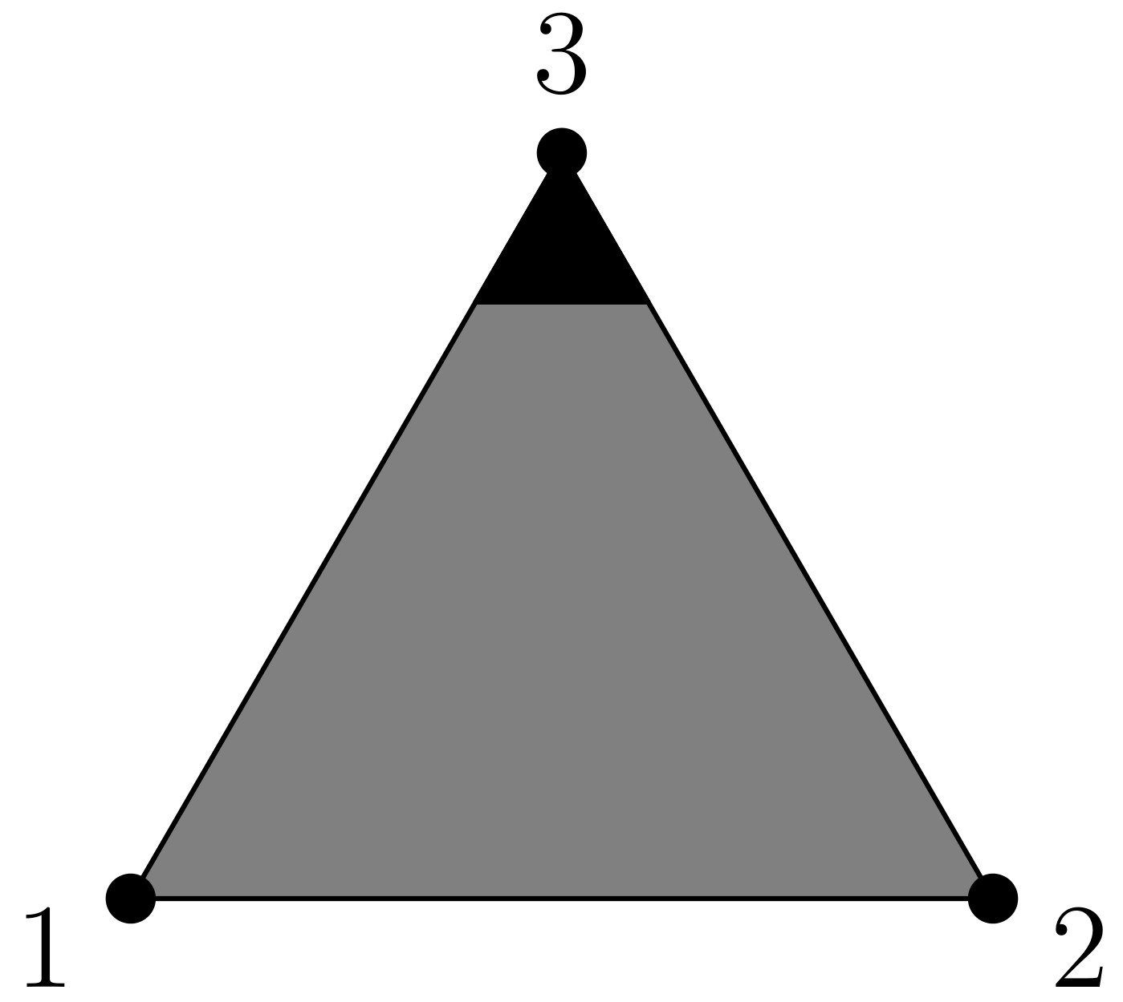
Simplicial complex construction
Instead of drawing a line from a number x to x+2 as before, we can have a “directed triangle.”

Slide 17
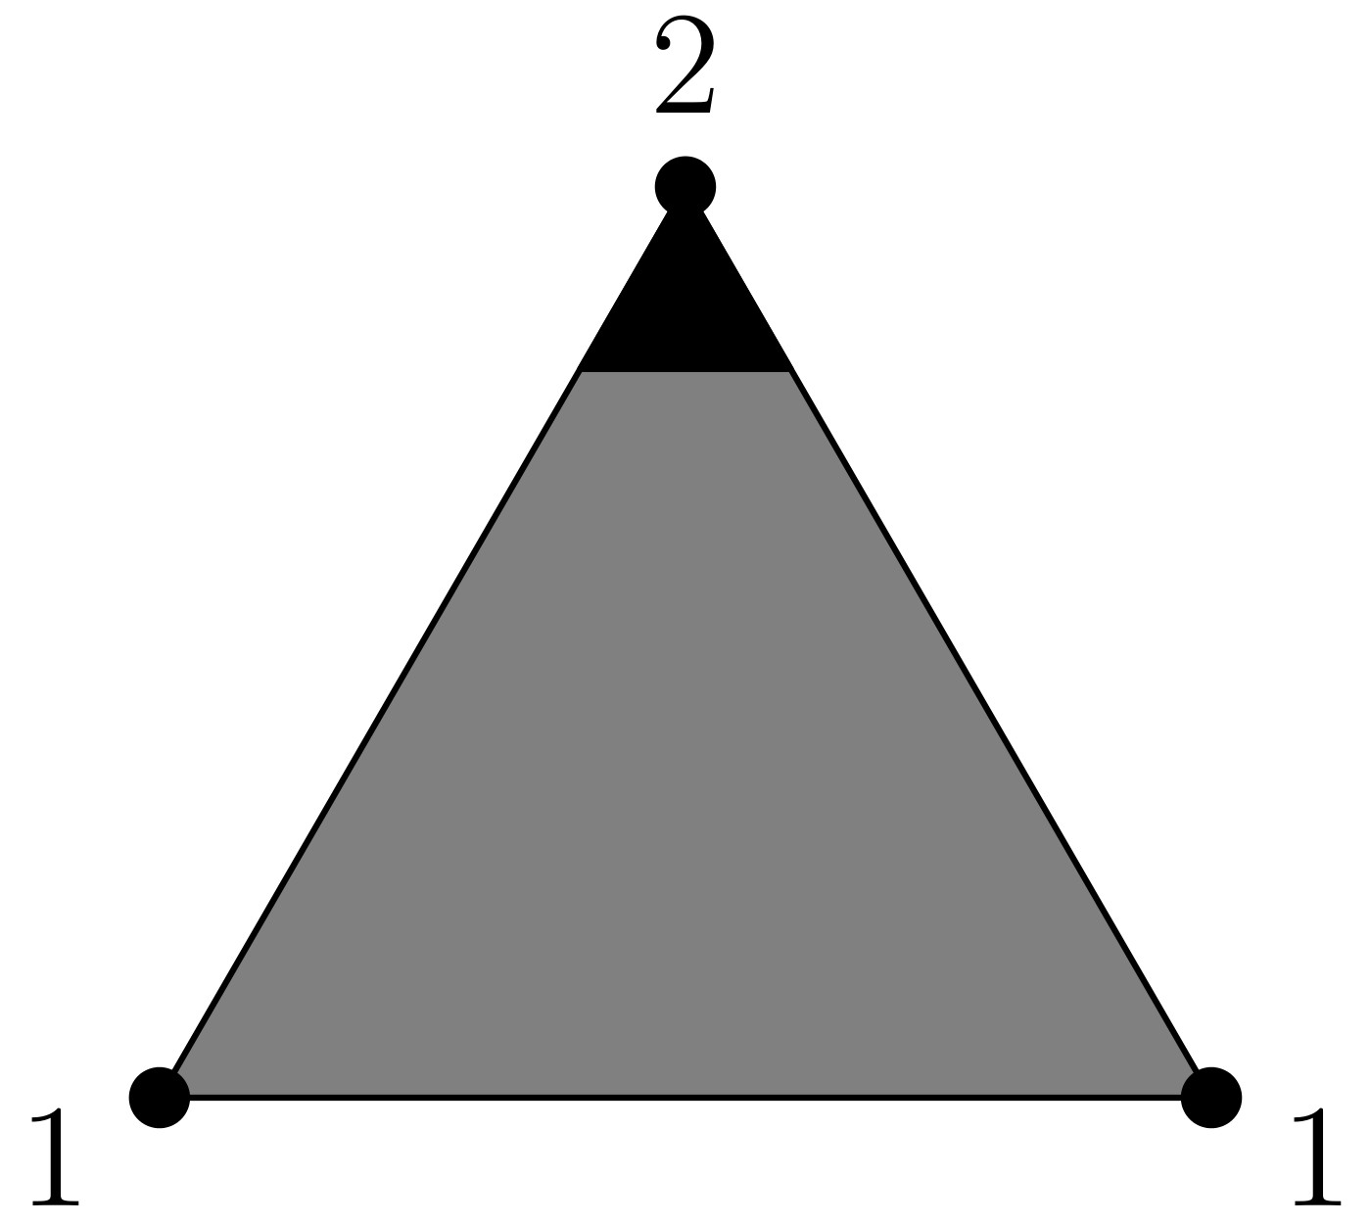
Simplicial complex construction
Since we only want one vertex per number, the triangle to the right presents a problem.

Slide 18
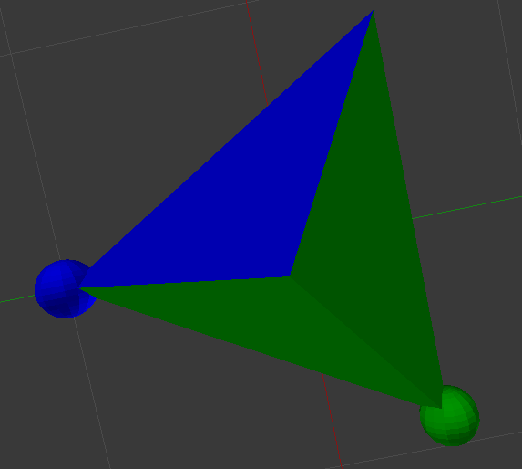
Simplicial complex construction

Slide 19
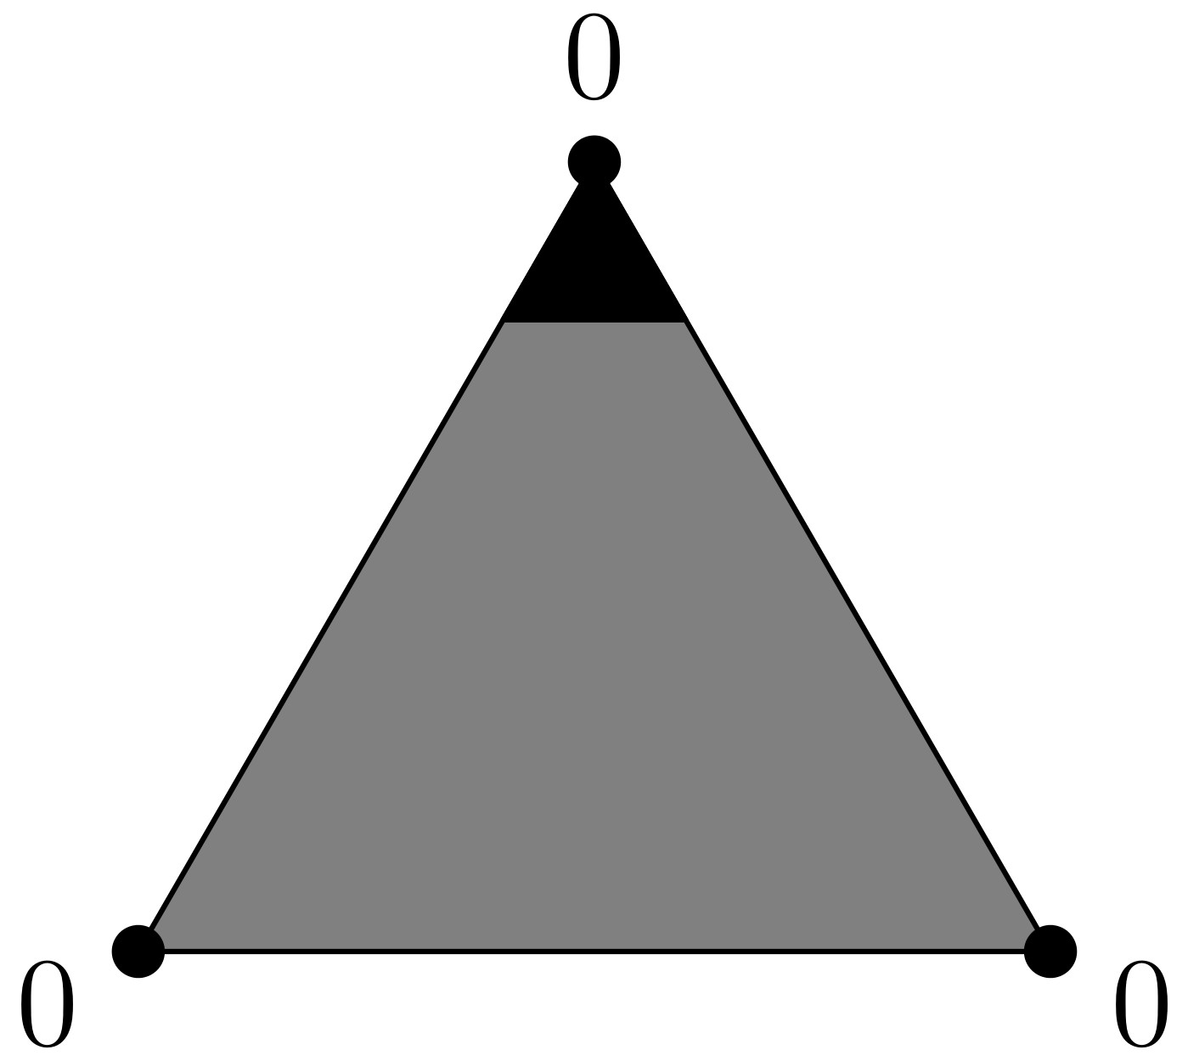
Simplicial complex construction
This triangle is even more troublesome, but can be dealt with in a similar fashion.

Slide 20
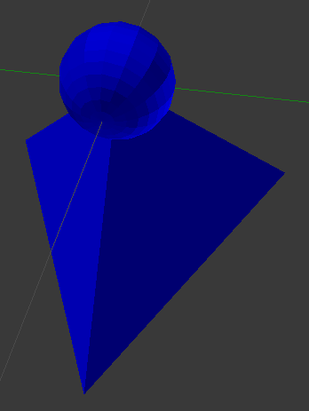
Simplicial complex construction

Slide 21
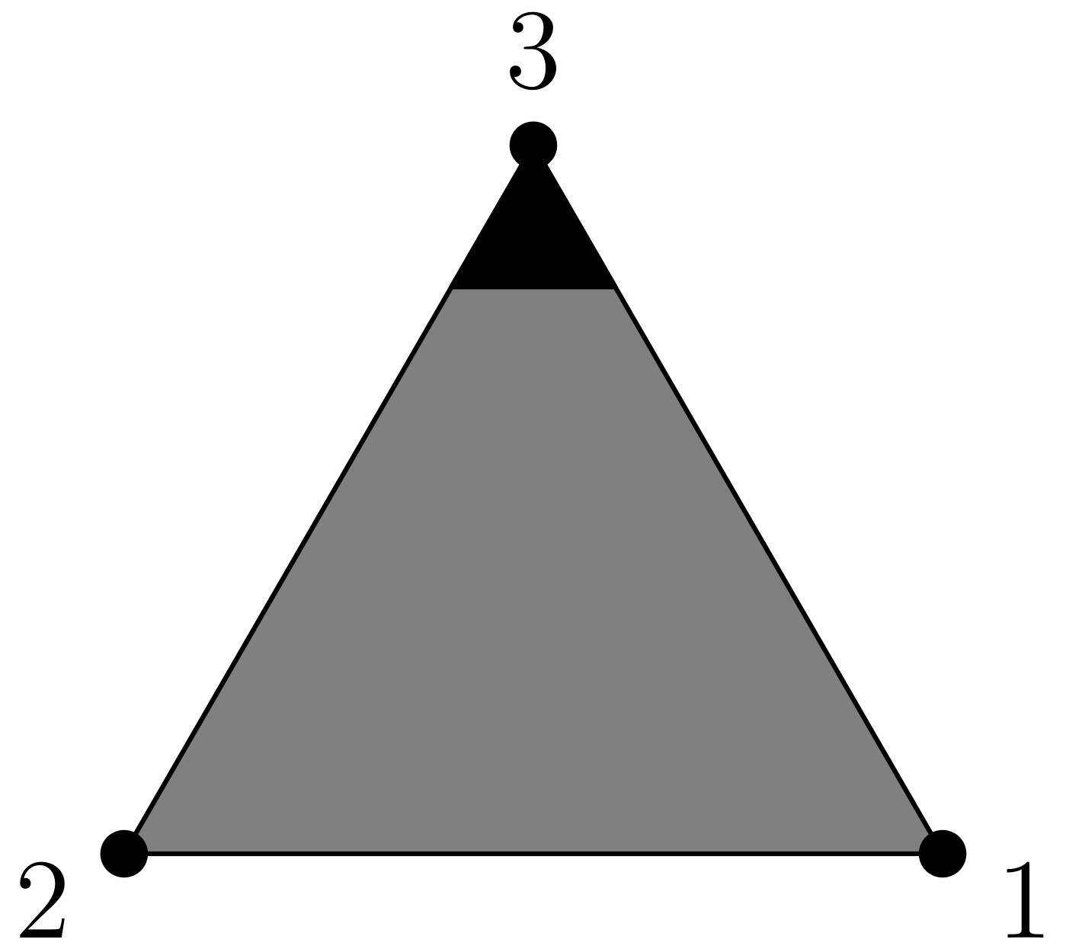
Simplicial complex construction
We can't always assume that a*b=b*a for some operation *.
This leads to an odd situation when, for example, 1+2=2+1.

Slide 22
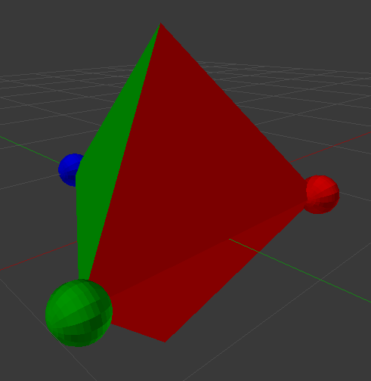
Simplicial complex construction

Slide 23
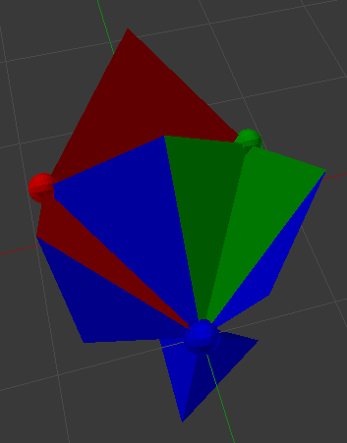
Simplicial complex construction
In the end we get an interesting shape.
The geometry of these shapes is already known for other reasons, which is useful.

Slide 24
Find Me on GitHub!
See github.com/caten2. Code and examples from this project to be uploaded shortly.

Slide 25
Acknowledgements
Jon Pakianathan
Mark Herman
Ronald E. McNair Post-Baccalaureate Achievement Program
Kearns Center
National Conference on Undergraduate Research

Slide 26
Questions.

